Slide 1
School & Community Data & Analysis
Steph Jordan

Slide 2
The Top 6 largest school districts in Georgia
,
Atlanta Public Schools - 88 schools 51,070 students 38,287 Black 14, 372 Hispanic
Clayton County- 69 schools 52,361 students 36,299 Black 11,949 Hispanic
Cobb County- 110 schools 107,231 students 32,684 Black 25,399 Hispanic
Dekalb County- 135 schools 93,348 students 55,341 Black 18, 307 Hispanic
Fulton County- 110 schools 90,323 students 38,287 Black 14,372 Hispanic
Gwinnett County- 140 schools 177,437 students 57,352 Black 58,044 Hispanic
Each school district has a high percentage of Black and Brown Students in retention and remedial classes. Additionally, there is low representation in Talented and Gifted programs. Most of the students are not in AP courses.

Slide 3
Focus on Fulton County Schools
Of the 90,323 students in Fulton County Schools, 38,287 are African-American and 14,372 are Hispanic. 11% of African-Americans and 5% of Hispanic/Latino students are in AP Math Classes. Only 14.3% of African- Americans and 7% of Hispanic/Latino students are in Gifted and Talented classes. The retention rate among African- Americans is 45% and 26% for Hispanic/Latino students. We are facing an educational crisis.
CivilRightsData.ed.gov

Slide 4
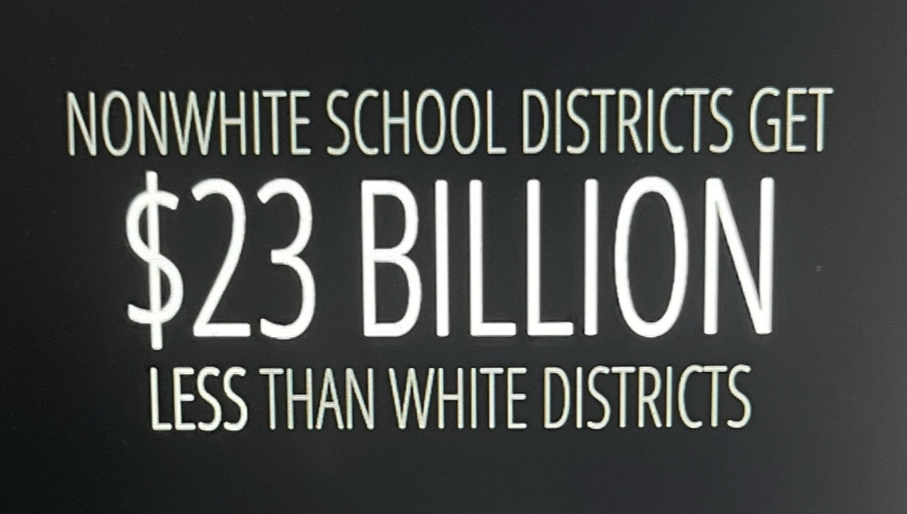
https://edbuild.org/content/category/problems

Slide 5
Why are our students failing?
There are historical and systemic disadvantages and opportunities for students in our communities. They have less access to resources, networks and opportunities. “Fractured: The Accelerating Breakdown of America's School Districts”
https://edbuild.org/content/category/problems
There is a lack of cultural relevance and representation in curriculum and teaching practices..
Our children have more exposure to biases and stereotypes in education.

Slide 6
Classroom Data- 100% African-American-90% remedial
Woodland Middle School Data
Student demographics: 89.1% Black, 8.1% Hispanic, 1.7% 2 or more races, <1.0% White
Teacher demographics: 85% African American, 7% White, 90% male, 10% female
Academic, 7% White, 90% male, 10% female
Achievement: 50% Beginning, 23% Proficient, 27% Above grade level
Discipline and Behavior: 35% Out of school suspension, 16% in school suspension, 484 behavioral incidents

Slide 7
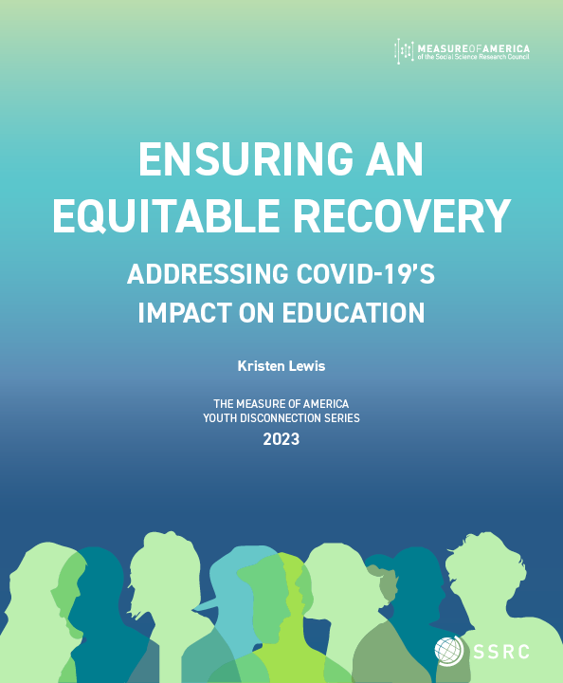
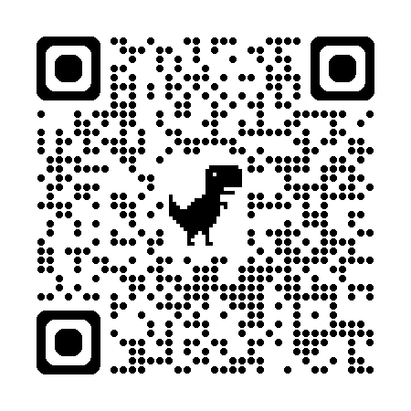
Systemic Injustices
Racism: Disparities in discipline and academic achievement between Black and Hispanic students, indicating potential biases and inequities.
The child maltreatment response rate increased 17% in the last 10 years, while the maltreatment victimization rate changed little
https://ojjdp.ojp.gov/publications/2022-national-report.pdf

Slide 8
Community Assets:
Atlanta Fulton Library Programs: Potential partner for literacy and educational resources.
Martin Luther King Center: Possible partner for character education and community engagement.
Strong Parent Teacher Organization at Woodland: Existing network for parent engagement and support.
The Grocery Spot: Free meals and food for teachers and students

Slide 9
Anti-racist and Intersectional Practices
Implement culturally responsive teaching practices to address disparities in academic achievement
Develop restorative justice practices to reduce suspensions and behavioral incidents.
Provide professional development on implicit bias and culturally responsive teaching.
Engage with community assets to enhance educational experiences and promote equity.

Slide 10
Recommendations
Incorporate diverse texts and materials, use culturally responsive pedagogy in teaching practices.
Include diverse perspectives and histories with district curriculum in designing curriculum.
Provide implicit bias training and culturally responsive teaching during professional development opportunities.
Collaborate with Atlanta Fulton Library, Food Resources through The Grocery Spot and local churches, the Martin Luther King Jr. Center and the Parent Teacher Organization for Community Partnerships.
South Fulton Arts Center Community Programs

Slide 11
Short-term goals:
Develop a professional development plan for teachers on Culturally Relevant Education and Leader in Me Schoolwide Intervention
Establish partnerships with After-School programs
Implement Restorative Justice Practices
Provide implicit bias training for teachers.
Develop and implement culturally responsive curriculum; develop a pilot curriculum using the H.I.L.L. framework for one grade level

Slide 12
Long-term goals:
Evaluation Metrics
Track changes in discipline and academic achievement
Strong participation in PBIS (Positive Behavior Intervention and Supports)
Monitor teacher and student feedback on culturally responsive practices. Evaluate and refine teaching methods and curriculum design based on student outcomes.

Slide 13
Evaluation Metrics
1. Teacher feedback and self-assessment on Culturally Relevant Education and Leader in Me Schoolwide intervention
2. Student engagement and motivation surveys.
3. Discipline and behavioral incident data.
4. Academic Achievement data (grades, test scores)
5. Parent and Community feedback on partnerships and programs
Student performance on H.I.L.L framework based assessments

